Slide 1
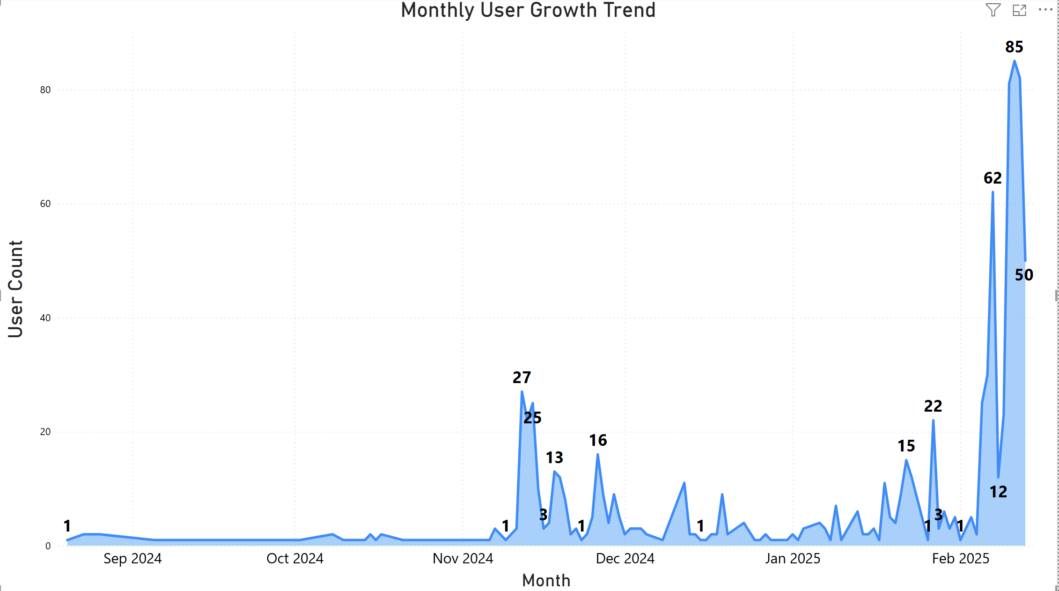
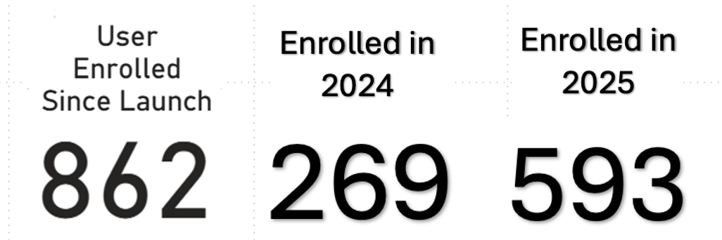

Slide 2

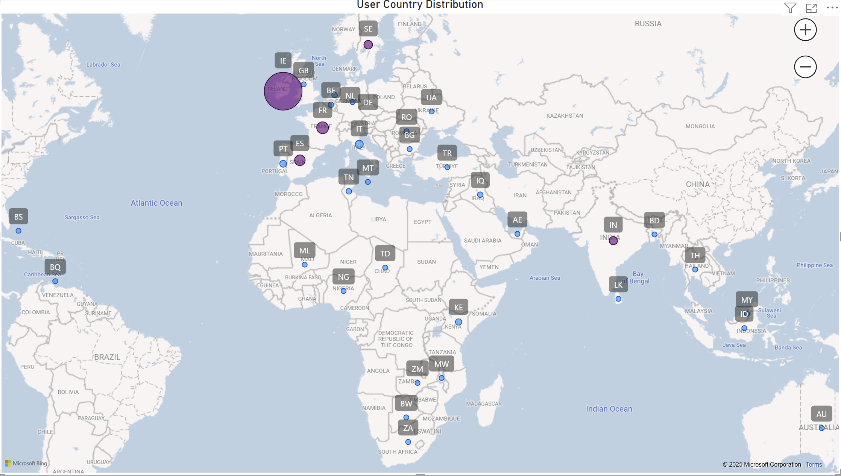
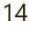
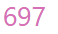
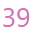
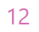


Slide 3
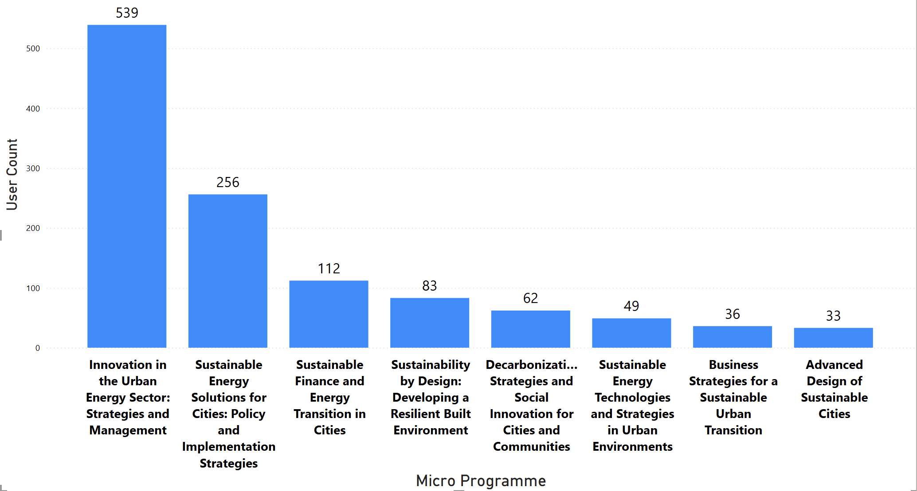


Slide 4
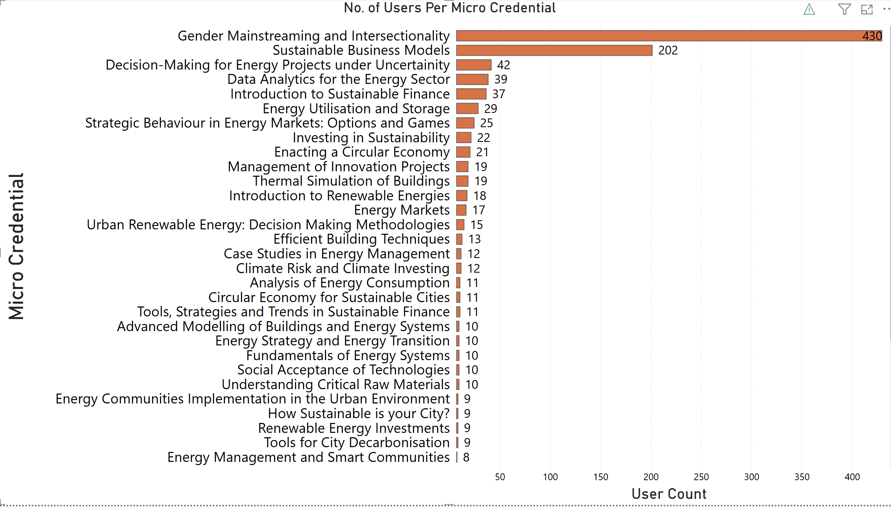
Notes:
hghgh

Slide 5

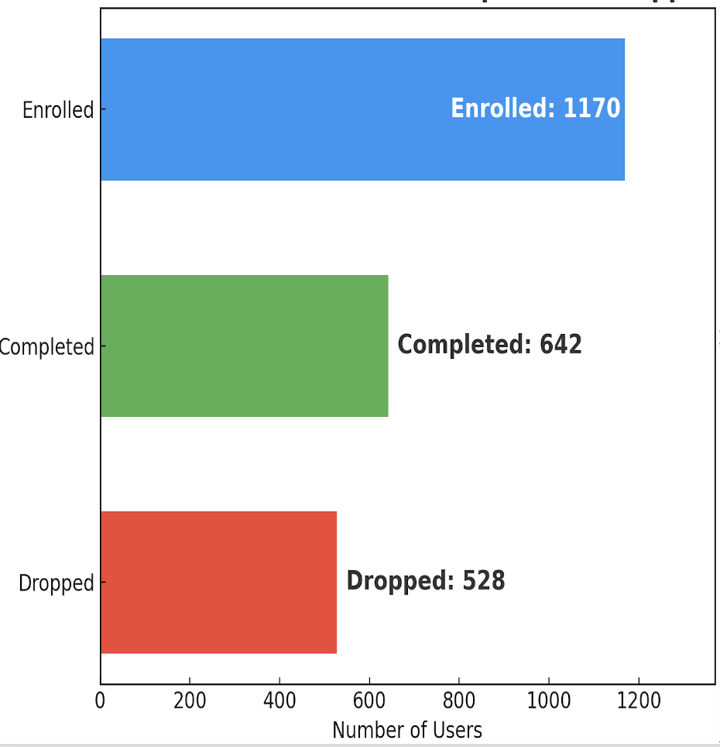
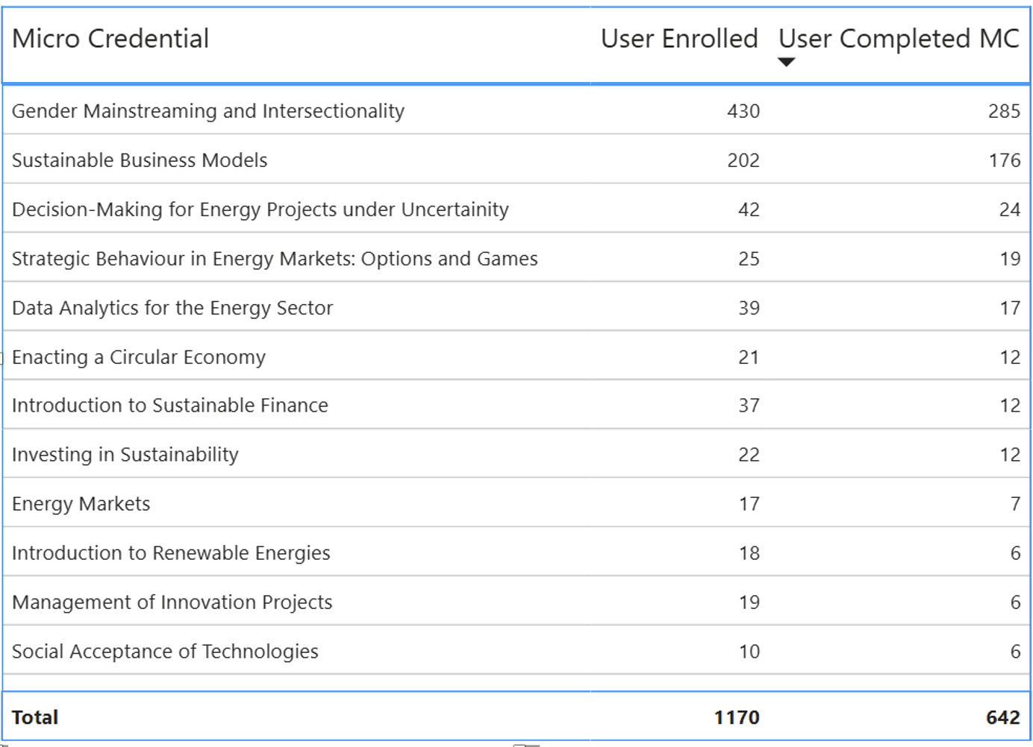
Micro Credential Completion vs Dropout Comparison

Slide 6
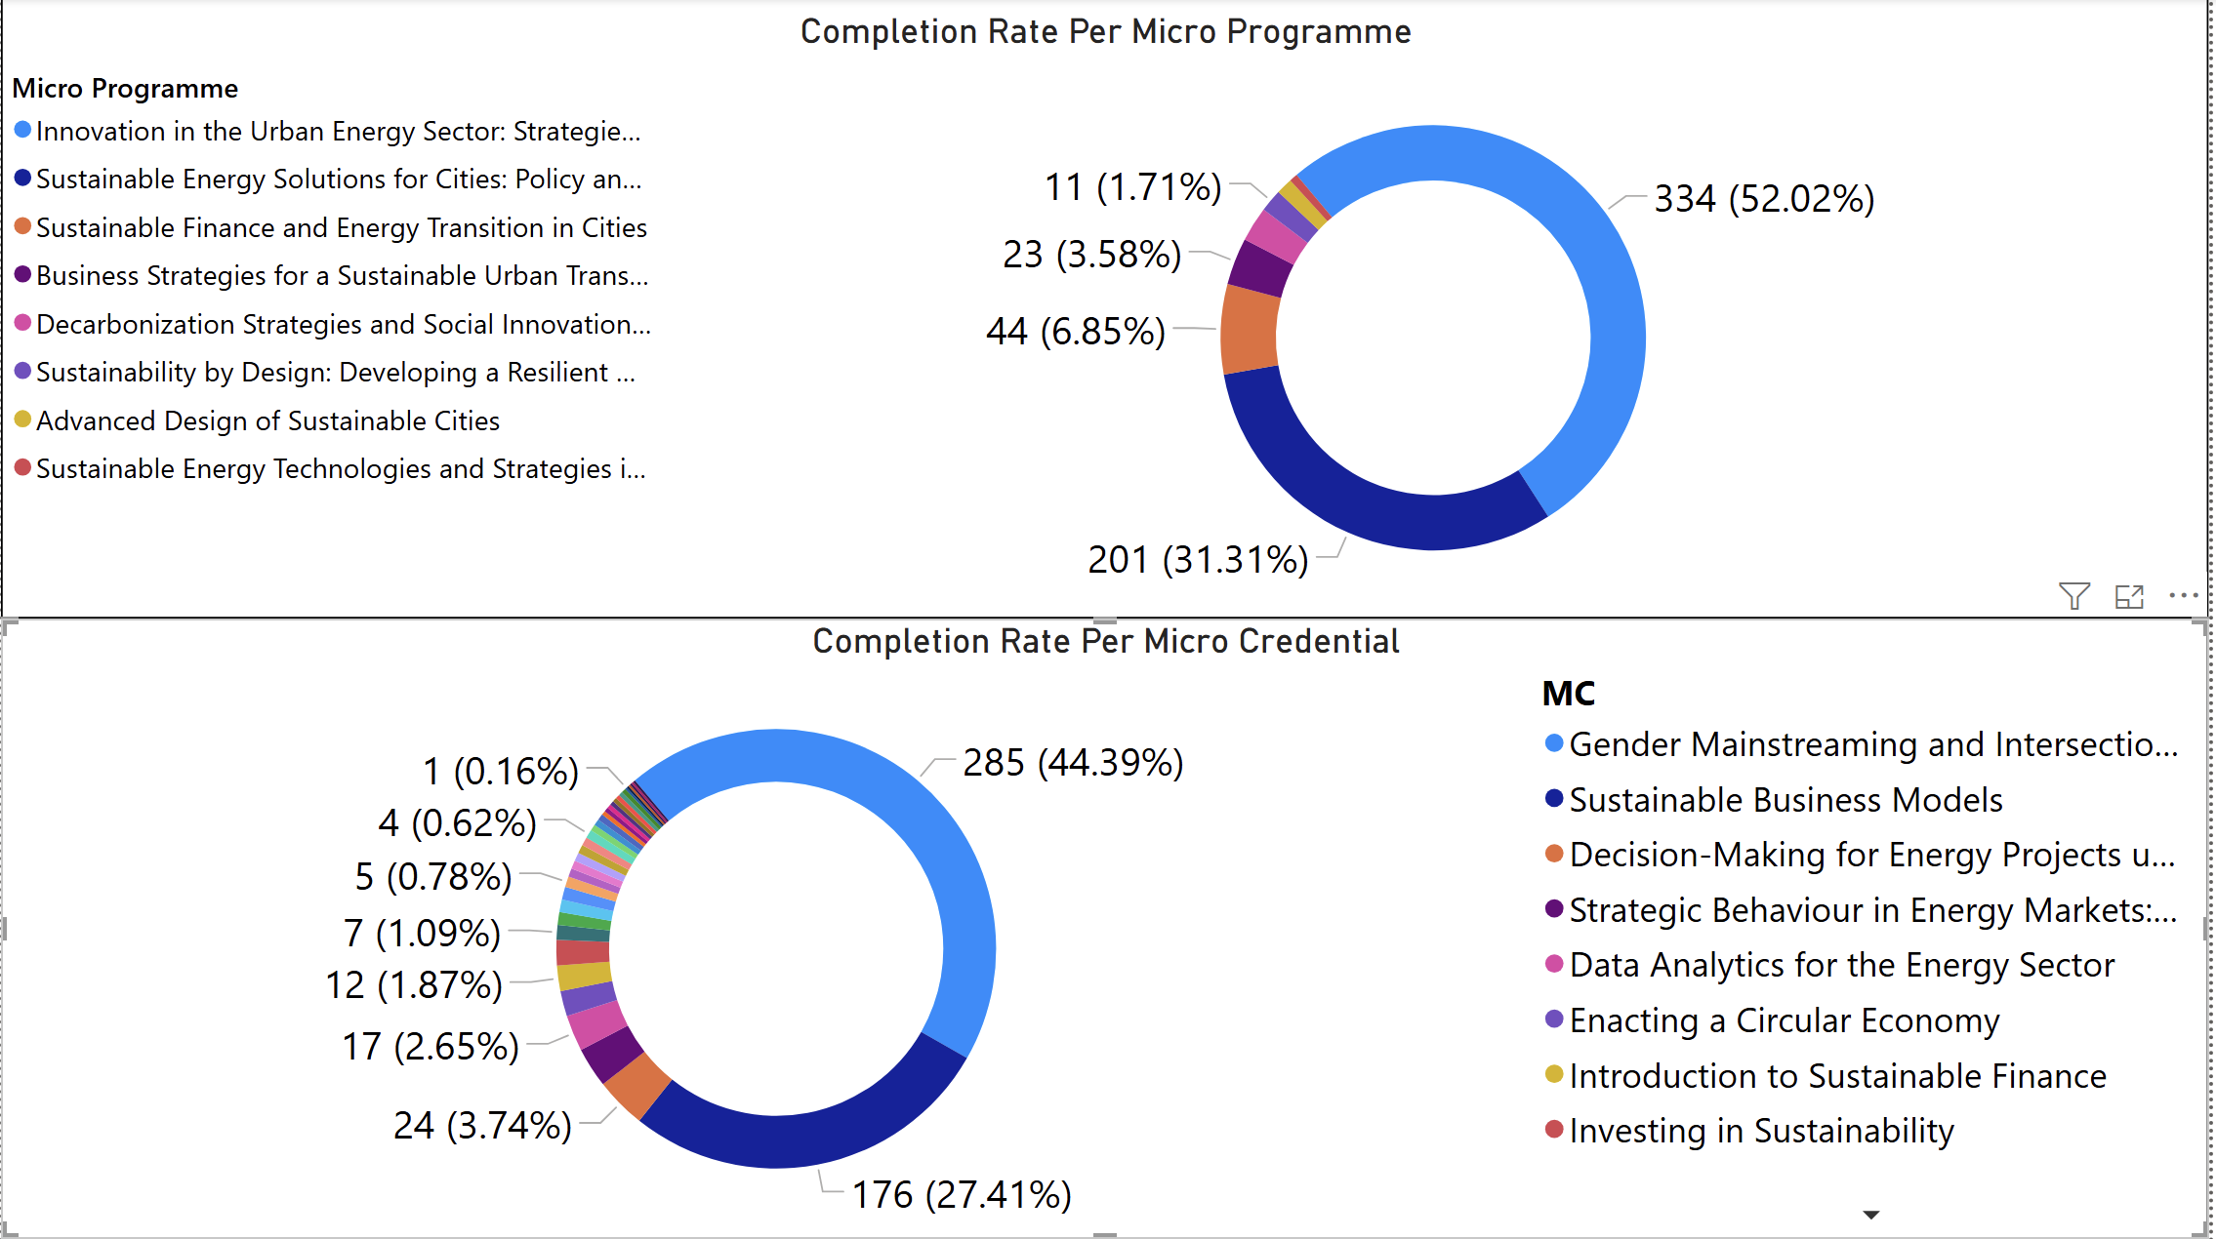

Slide 8
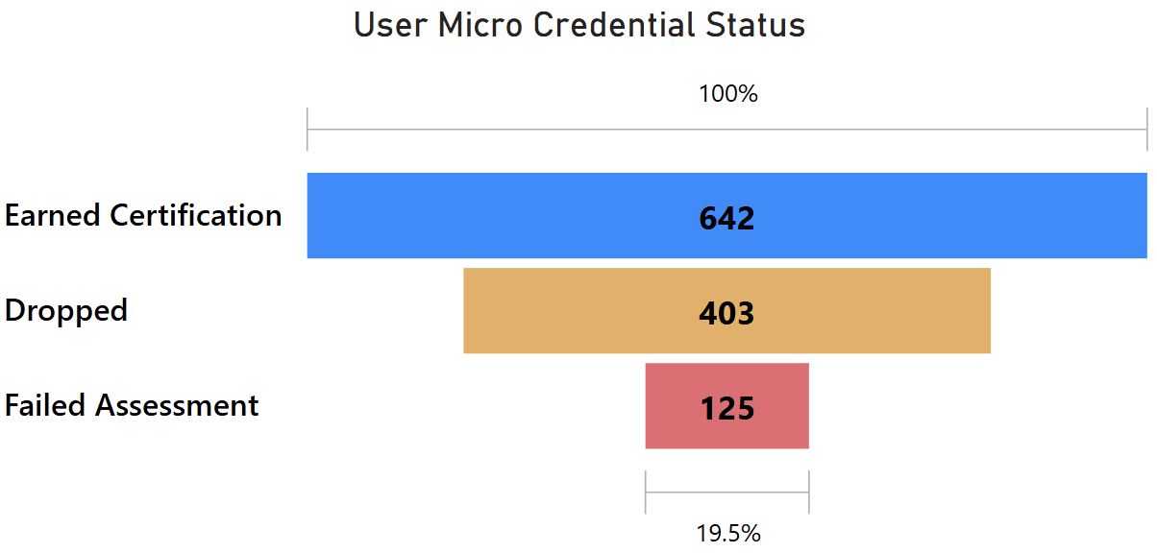
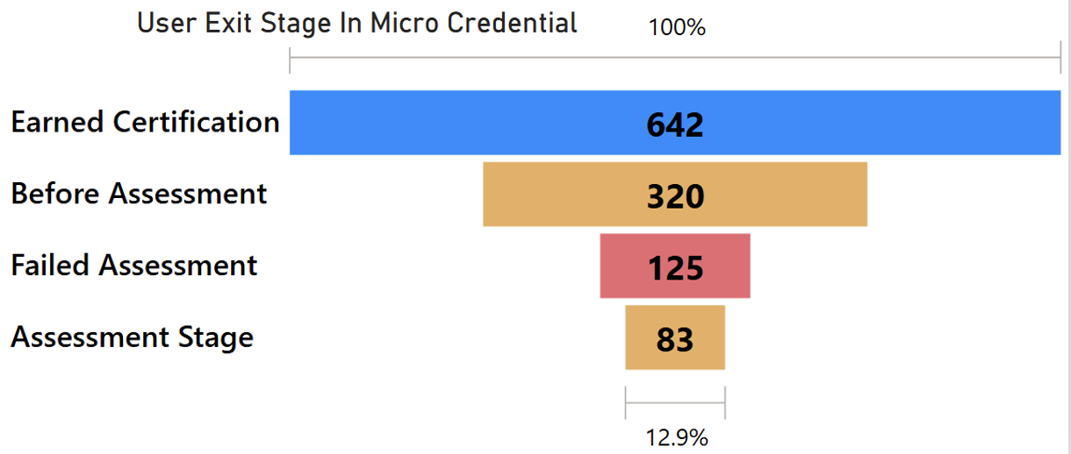
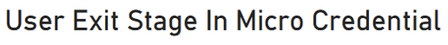
User Exit Stage | User Count | User%
Earned Certification | 642 | 54.87%
Dropped | 403 | 34.44%
Failed Assessment | 125 | 10.68%
Total | 1170 | 100.00%
Dropped Users | User Count | User%
Before Assessment | 320 | 79.40%
Assessment Stage | 83 | 20.60%
Total | 403 | 100.00%

Slide 9
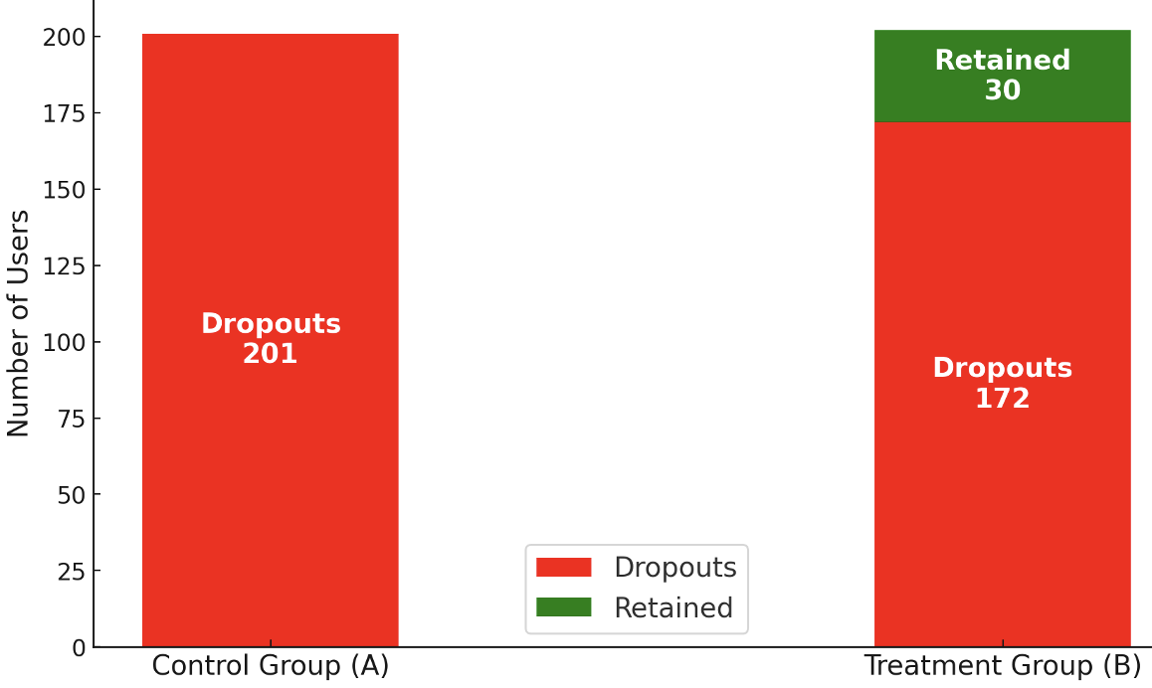
Group | Total Users | Dropouts | Retained Users | Dropout Rate (%)
A (Control) | 201 | 201 | 0 | 100
B (Treatment) | 202 | 172 | 30 | 85.15
A/B Test: Personalized Reminder Impact on Dropouts
Source: Research Article

Slide 10

Tailored Education Programs

Slide 11
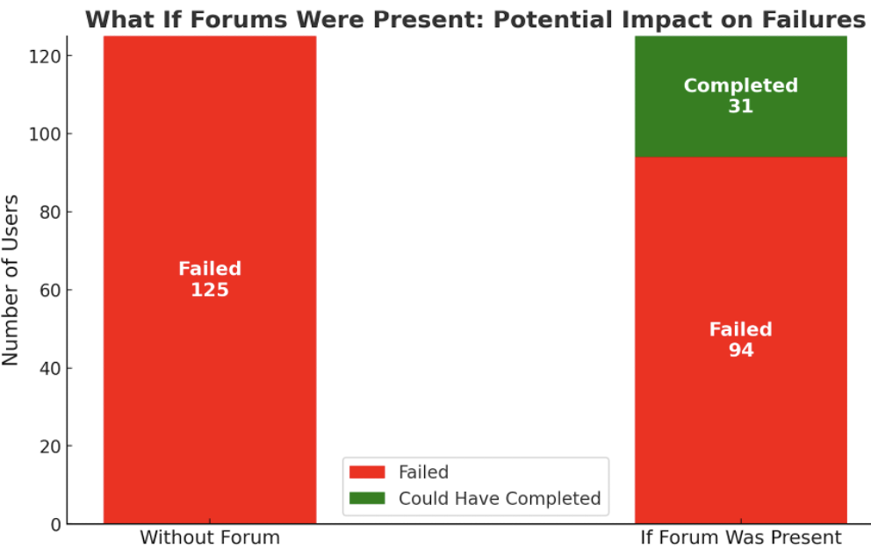
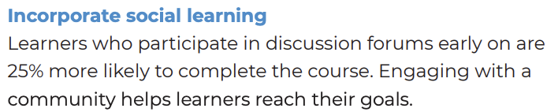
Community Engagement and Peer Discussion
Coursera

Slide 12
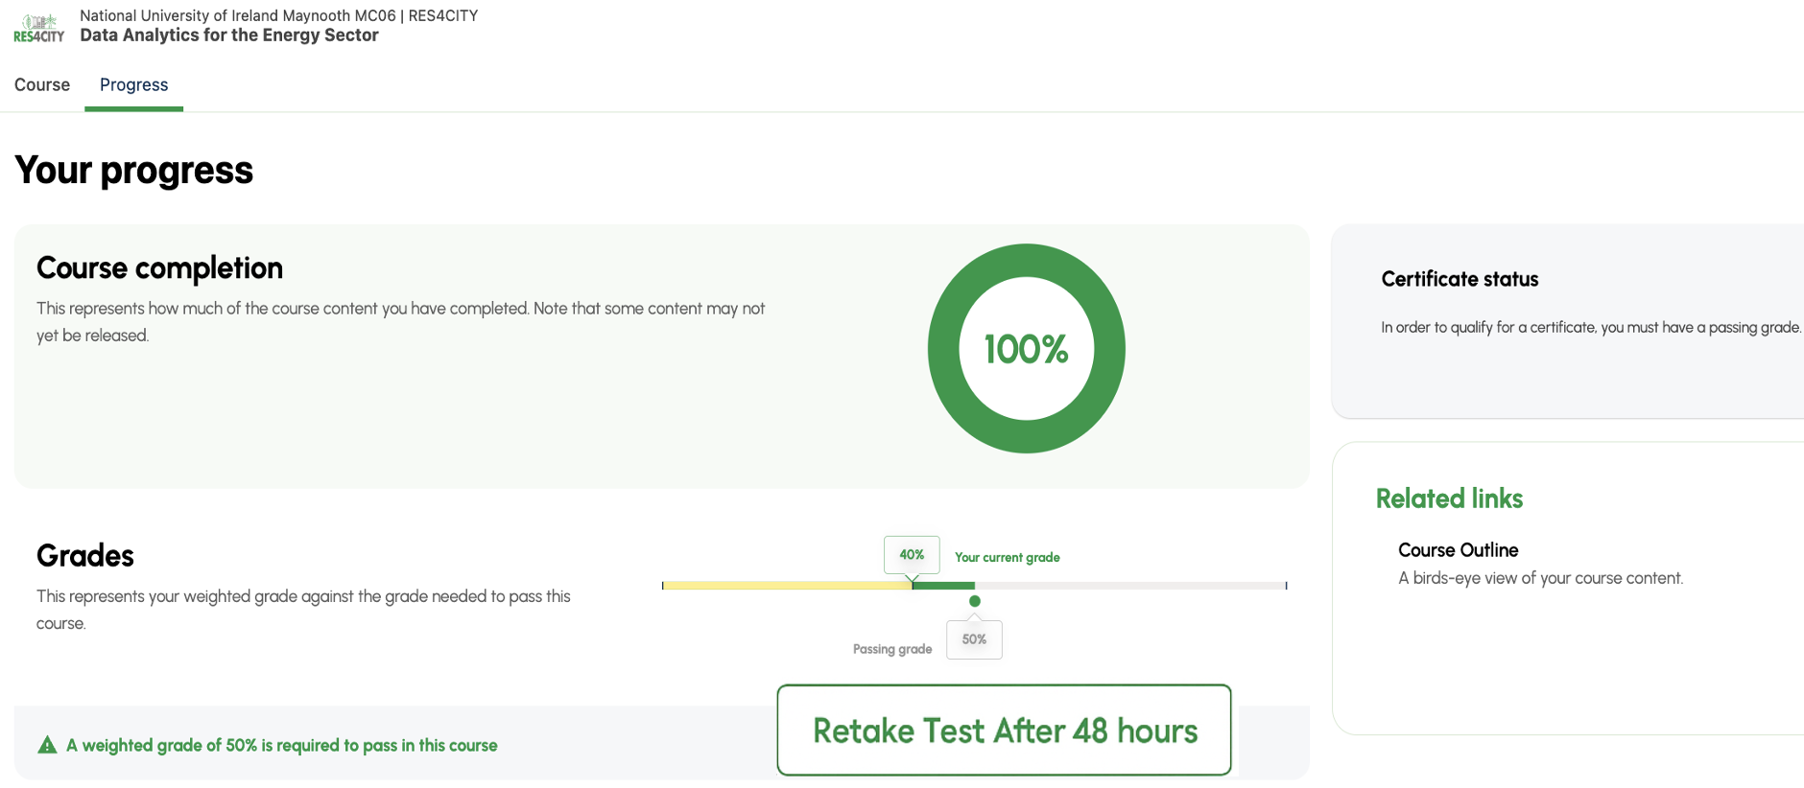
Re-Assessment Opportunity

Slide 13
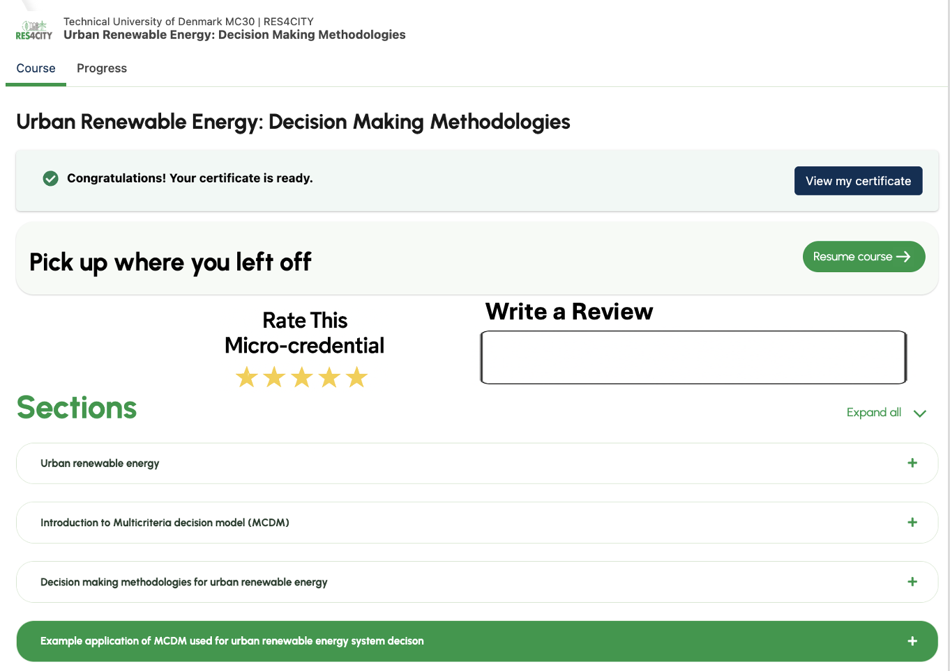
Rating
and
Feedback

